Slide 1
Battle of The Neighbourhoods
Ankit Saxena

Slide 2
Overview
With about 8.5 million people calling the city home, NYC remains one of the fastest growing cities in the world. Its demographics include a variety of diverse cultures & cuisines. This essentially means that whatever type of food you love, there is still hope for you in NYC. This report will try to analyze the data publicly available for NYC & try to answer the following questions:
• Which parts of NYC have the most Japanese restaurants?
• Which is the best location in NYC for Japanese cuisine?
• Which areas have a dearth of Japanese restaurants?
• What would be the best place to stay in NYC if you’re in love with sushi?
This analysis will help fellow sushi lovers to find their favorite place in the great city of New York. It might also help any individual(s) or companies looking to open a Japanese restaurant in the city.

Slide 3
Dataset(s)
The following datasets will be used for this analysis:
• NYC location dataset
o Source: https://cocl.us/new_york_dataset
o Dataset includes names of neighborhoods, boroughs & their respective location coordinates.
• Japanese restaurants location & info
o Source: Foursquare API
o The API will be used to search for Japanese restaurants in NYC’s neighborhoods.
• Boundary Data
o Source: : https://data.cityofnewyork.us/City-Government/BoroughBoundaries/tqmj-j8zm
o This boundary data for the boroughs will help us plot the choropleth map of NYC.

Slide 4
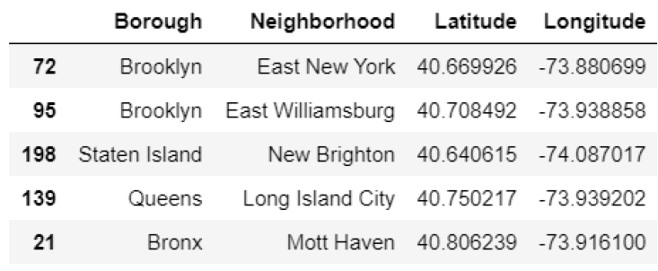
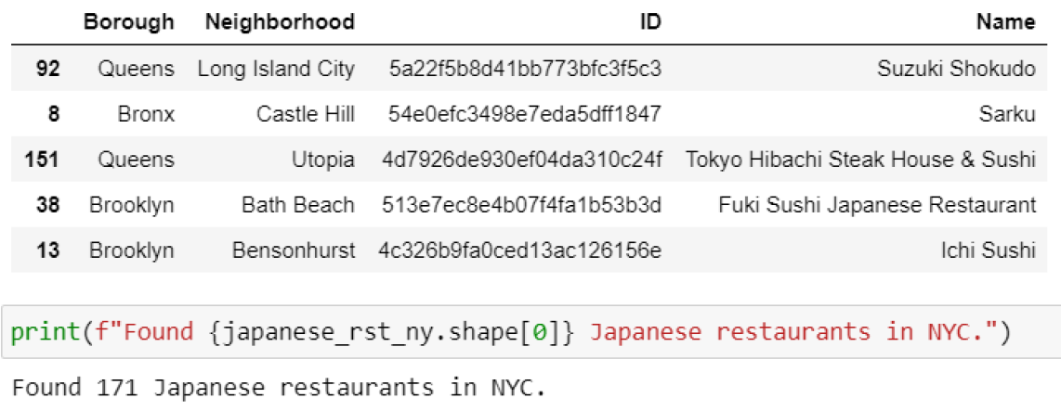
Methodology
In order to explore the data, we first try to make sense of a sample from it. We find out that the dataset lists a total of 306 neighborhoods along with the borough they belong to & their respective latitudes & longitudes.
To continue with our analysis, we get a list of all the Japanese restaurants in NYC from the Foursquare API.
We find ourselves with 171 Japanese restaurants in the City of New York across all neighborhoods & boroughs. Further, we visualize the data Borough-wise & Neighborhood-wise.

Slide 5
Visualizations

Slide 6
Choropleth Map

Slide 7
Results & Discussion
We can confidently say that Brooklyn has the largest number of Japanese restaurants. Bath Beach & Murray Hill top the list neighborhood-wise with 5 Japanese Restaurants each.
We also found out that Bronx does not have any Japanese restaurants, which might mean that there is potential in the area. It might also mean that the people residing in Bronx just do not like sushi that much. More data is needed to reach a definitive answer.
Conclusion
We started with the raw datasets & certain questions we wanted to answer. With the help of Explorative Data Analysis, we visualized & analyzed the data to find the answers to these questions. We also produced a handy map to visualize our results.
Further work can be done by improving the dataset, by adding the rankings of the restaurants & then ranking them accordingly.

